Slide 1

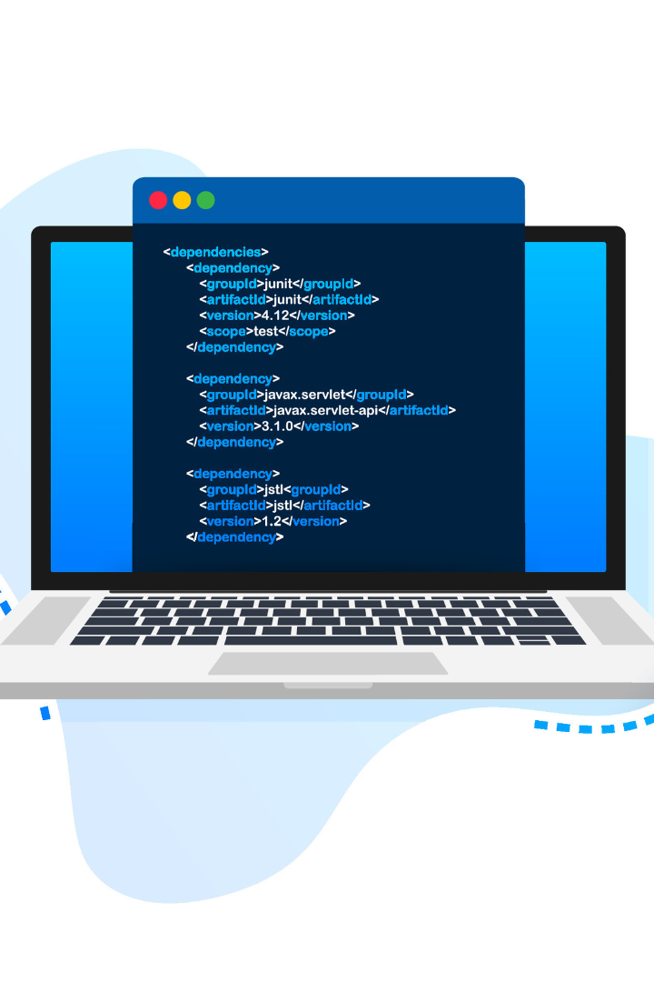
Introducing Our Note-taking App → BlissfulBytes
Submitted By : Vanshika Bhatia (2110992260)
Aryan Raj (2110992048)

Slide 2

Setting up the Environment
Installing Node.js and NPM
Get started by setting up the Node.js runtime environment and the Node Package Manager (NPM) on your machine.
Creating a New Express.js Project
Learn how to initialize a new Express.js project and get it up and running in no time.
Installing and Configuring Mongoose
Install and configure Mongoose, a powerful Object Data Modeling (ODM) library for MongoDB, to efficiently manage data in your blogging website.

Slide 3
Building the Backend
1
Designing the Database Schema
Create a well-structured database schema to effectively store and organize blog posts, user data, and other vital information.
2
Creating API Endpoints for CRUD Operations
Develop API endpoints using Express.js to handle Create, Read, Update, and Delete (CRUD) operations on blog posts and user data.
3
Implementing Authentication and Authorization
Enhance the security of your blogging website by implementing user authentication and authorization using various strategies like JWT and session-based authentication.

Slide 4
Developing the Frontend
Overview of Frontend Technologies
Building the User Interface
Integrating with Backend APIs
Create a captivating user interface for your blogging website using templating engines or modern frontend frameworks like React or Vue.js.
Establish a seamless connection between the frontend and backend by making API calls to fetch blog posts, handle user input, and display dynamic content.
Explore the fundamentals of HTML, CSS, and JavaScript, the building blocks of web development, and gain insights into their roles in creating a dynamic user interface.

Slide 5

Enhancing the Website
1
Implementing Interactive Features
Engage your users by adding interactive features like commenting, sharing, and liking to foster engagement and community.
2
Optimizing Performance and Security
Learn best practices to optimize your website's performance and security, ensuring a smooth and secure user experience.
3
Deploying the Website
Take your blogging website live by deploying it to a reliable hosting platform, making it accessible to users worldwide.

Slide 6

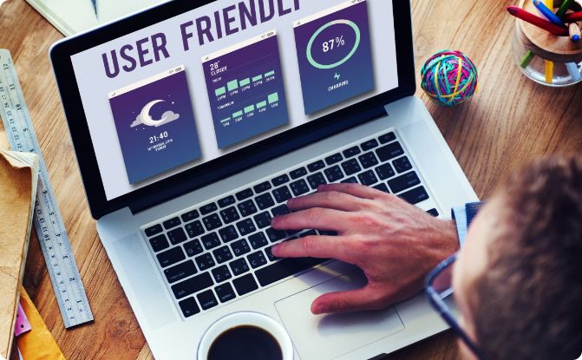
Conclusion
Recap of the Main Points Discussed
Importance of a User-Friendly and Scalable Blogging Website
Summarize the key concepts and techniques covered throughout the presentation, empowering attendees to build their own blogging websites.
Highlight the significance of crafting a user-friendly and scalable blogging website to attract and retain readers, build a community, and achieve success.

